Slide 2
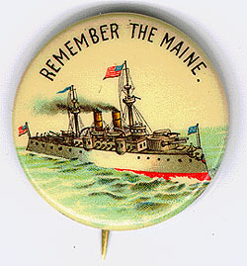
IMPERIALISM
TOPIC 2
THE SPANISH-AMERICAN WAR –
AMERICA’S “COMING OUT” PARTY!

Slide 3
Essential Questions
Describe and evaluate the causes, course, and consequences of the Spanish-American War.

Slide 4
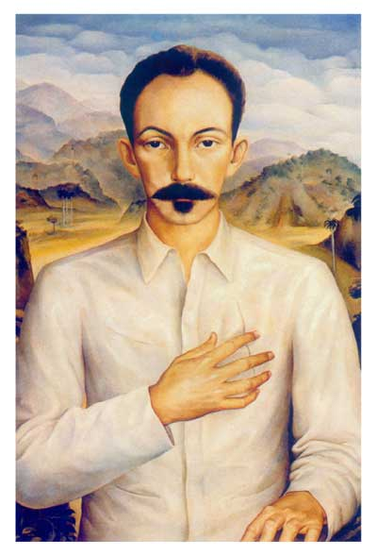
Spanish Cuba
Cuba was one of Spain’s oldest colonies and generated wealth in sugarcane production, but Cubans struggled for independence.
Jose Marti, a Cuban rebel, poet and writer, brought Cuban exiles together in the United States, to raise funds for a renewed rebellion.
By the 1890s, the US had invested heavily in Cuba, and the Spanish depended upon trade with the US.
In 1894, the US placed a tariff on Cuban sugar, severely disrupting the Cuban economy which was based on sugar production.
In the midst of economic crisis, Marti’s followers launched their rebellion against the Spanish, hoping for US support.

Slide 5
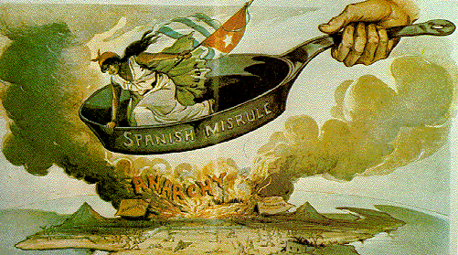
More Problems in Cuba
In 1896 Spain sent General Valeriano “the Butcher” Weyler to Cuba to put down the revolt.
  Created concentration camps for the 300,000 rural inhabitants, where thousands died
  US citizens were outraged by the treatment, but Cleveland refused to support a call for war.
In 1897, Spain removed the Valeriano Weyler, but conditions did not change much.

Slide 6
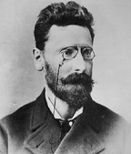
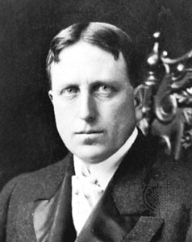
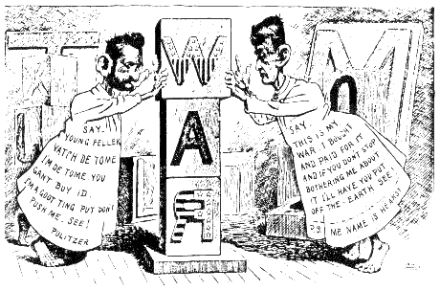
Yellow Journalism
Joseph Pulitzer, NY World
William Randolph Hearst, NY Journal
Frederic Remington, artist
  Hearst told him, “You furnish the pictures and I’ll furnish the war.”
When the Journal reported stories of the Spanish feeding Cuban prisoners to sharks and dogs, the World described the “blood on the roadsides, blood in the fields, blood on the doorsteps, blood, blood, blood!”

Slide 7
From Neutrality to War
Neutrality
Despite the sympathy created by newspapers in the United States, this sensational reporting was not enough to declare war.
1897 President William McKinley, believed war with Spain should be avoided, and he attempted negotiations.
Spain “threw McKinley a bone,” offering Cubans some autonomy…the Cubans flatly refused.
Loyalists in Havana rioted against Spanish concessions to the rebels.

Slide 8
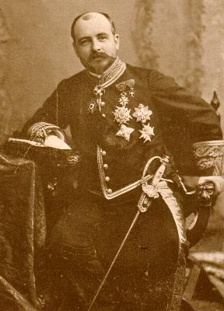
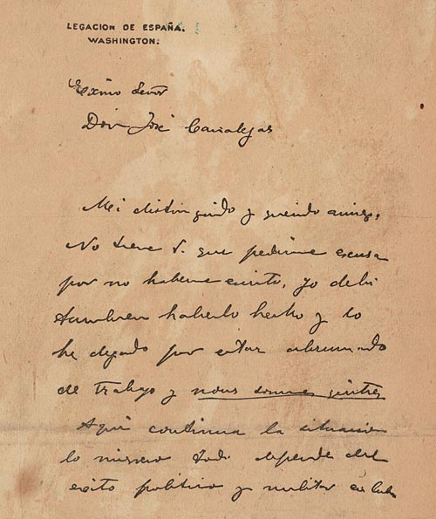
Enrique Dupay de Lome
The New York Journal printed a stolen letter, written by the Spanish ambassador to the US, that called President McKinley “weak” and “a bidder for the admiration of the crowd.”
Oh, it’s on.
Jingoism
Members of the Republican Party, like young Theodore Roosevelt, were itching for a fight, and said that McKinley had the backbone of a “chocolate éclair,” if he ignored the insults of Spain.

Slide 9
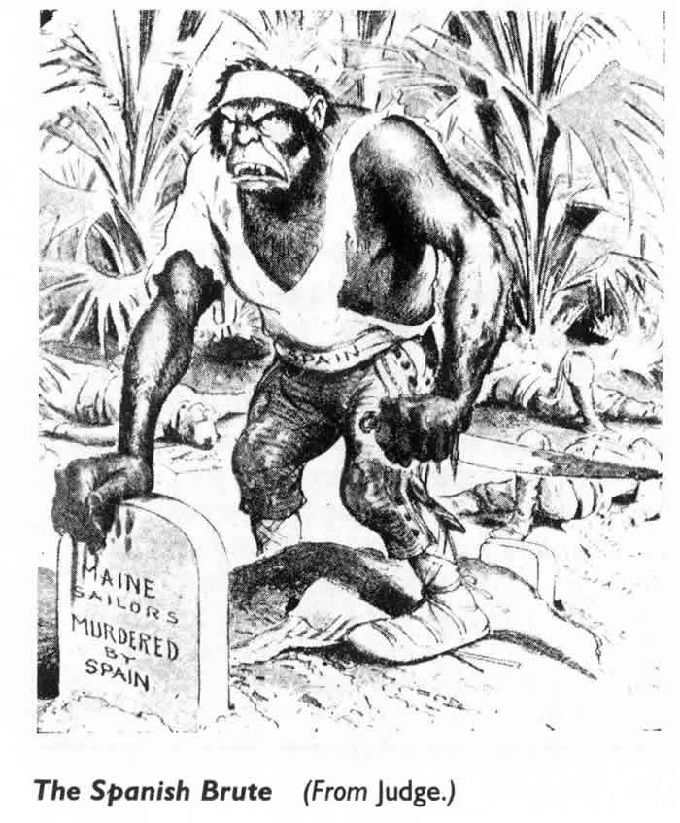
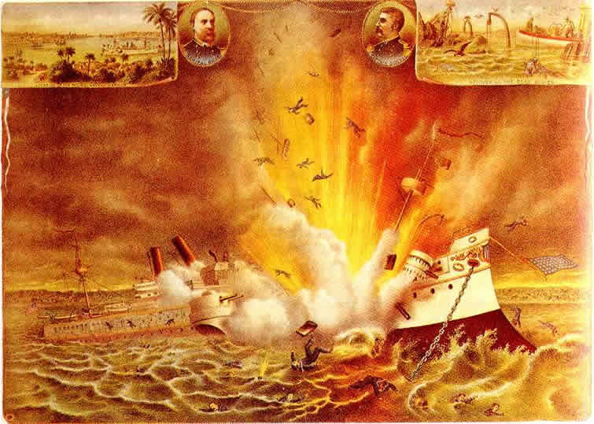
“Remember the Maine and to Hell with Spain!”
U.S.S. Maine sent to evacuate Americans from Havana and protect American interests, the ship exploded, killing 266 sailors.

Slide 10

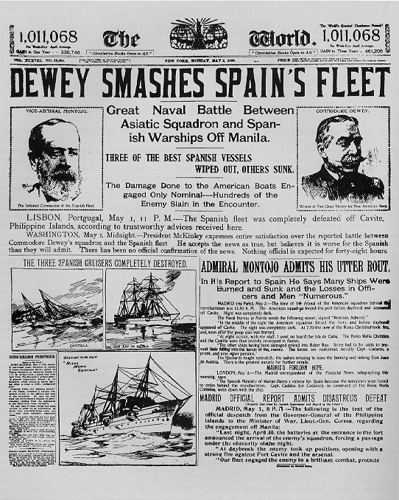
Two Front War
In the Philippines
Commodore George Dewey
Destroys the Spanish Fleet in Manila Bay. Reinforcements, on the way to assist, decide to take the island of Guam, too.
Emilio Aguinaldo
The leader of the Filipino rebels helps Dewey, thinking the Americans were allies…until they seized the capital and threw him out!

Slide 11
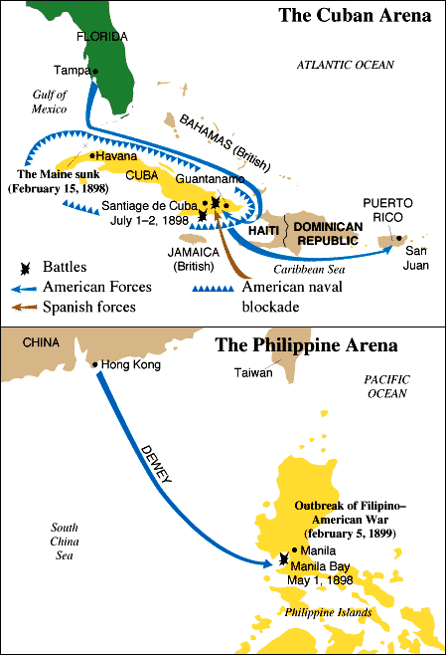
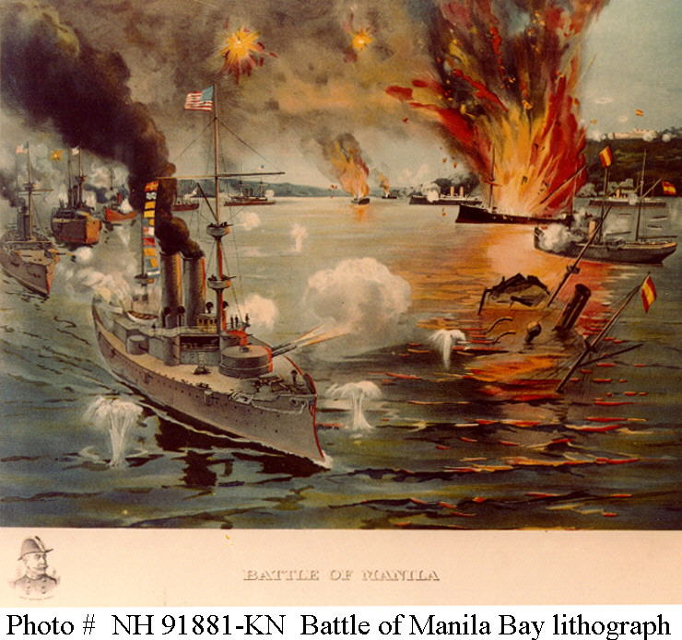

Slide 12
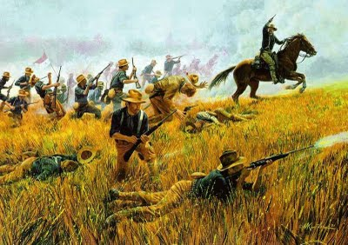
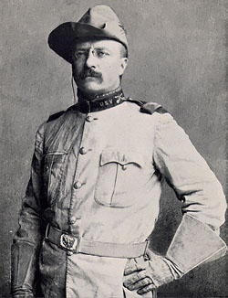
Two Front War
In the Caribbean
American Forces in Cuba
Inexperienced, ill-trained, equipped with wool uniforms, poorly led and even more poorly fed.
17,000 troops were ordered to Santiago to force Spanish Fleet out of hiding including 4 African American regiments of the regular army and the Rough Riders (volunteer cavalry) led by Colonel Leonard Wood and Lt. Colonel Theodore Roosevelt.
American troops won at San Juan Hill, Kettle Hill, and El Caney forcing the Spanish fleet to flee (then destroyed).

Slide 13
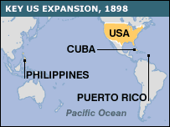
Still in the Caribbean
Next Stop, Puerto Rico…
Under General Nelson Miles, American troops landed and took Puerto Rico.

Slide 15
ARMISTICE
AUG 12, 1898
The Toll of the War
Treaty of Paris
US Secretary of State John Hay, called the 113 days of battle a “splendid little war.”
Only 379 Americans died from Spanish bullets.
Over 5,000 Americans died from malaria, typhoid, dysentery, yellow fever, and food poisoning.
Dec 10, 1898
As promised in the TELLER Amendment, Cuba became independent.
US is given Puerto Rico and Guam.
US paid $20 million to annex the Philippines.
Feb 6, 1899
Senate passed the treaty.

Slide 16
“When I next realized that the Philippines had dropped into our laps I confess I did not know what to do with them. . . And one night late it came to me this way. . . 1) That we could not give them back to Spain- that would be cowardly and dishonorable; 2) that we could not turn them over to France and Germany . . .that would be bad business and discreditable; 3) that we not leave them to themselves-they are unfit for self-government-and they would soon have anarchy and misrule over there worse than Spain's wars; and 4) that there was nothing left for us to do but to take them all, and to educate the Filipinos, and uplift and civilize and Christianize them . . .” President William McKinley

Slide 17
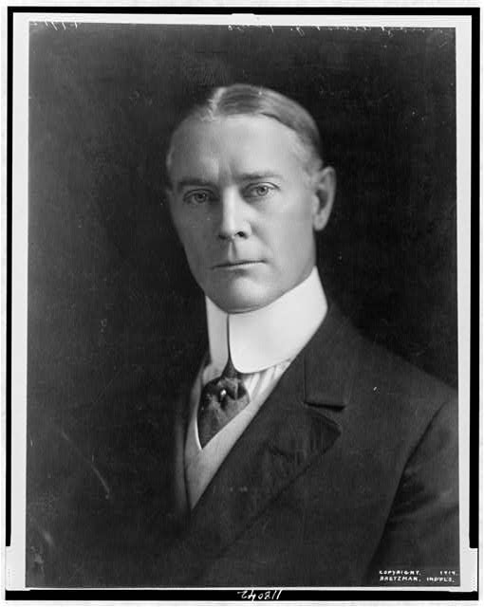
“The opposition tells us that we ought not to govern a people without their consent. I answer, The rule of liberty that all just government derives its authority from the consent of the governed, applies only to those who are capable of self government…Would not the people of the Philippines prefer the just, humane, civilizing government of this Republic to the savage, bloody rule from pillage and extortion from which we have rescued them?”
-Senator Albert J. Beveridge (IN)

Slide 18
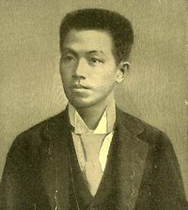
TROUBLE IN THE PHILIPPINES
Debate erupted over the annexation of the Philippines.
Too Distant and populated by alien race, tongue, religion & government.
Anti-Imperialist League formed by William Jennings Bryan, Mark Twain, Samuel Gompers, and Andrew Carnegie.
Filipinos wanted independence.
Feb 4, 1899
Revolt against US led by Emilio Aguinaldo using guerrilla warfare.
Filipinos are sent to concentration camps.
1901
Aguinaldo was captured.
1902
Revolt ended, with 20,000 Filipinos and 4,000 Americans dead.

Slide 19
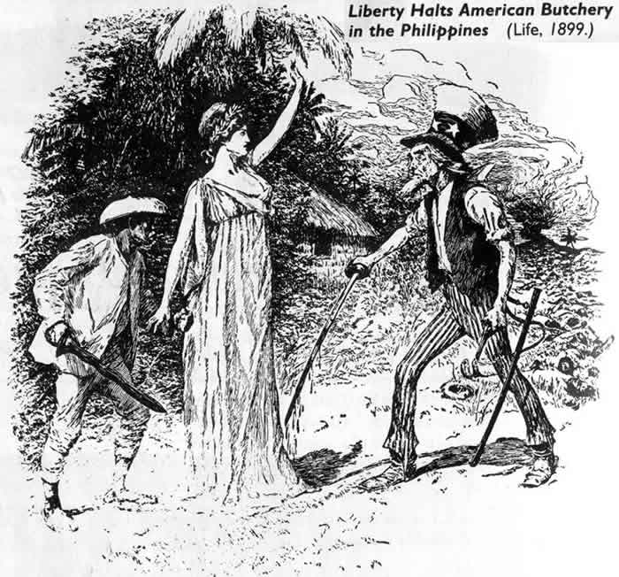

Slide 20
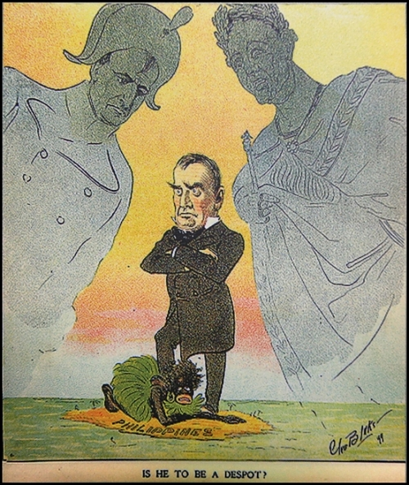
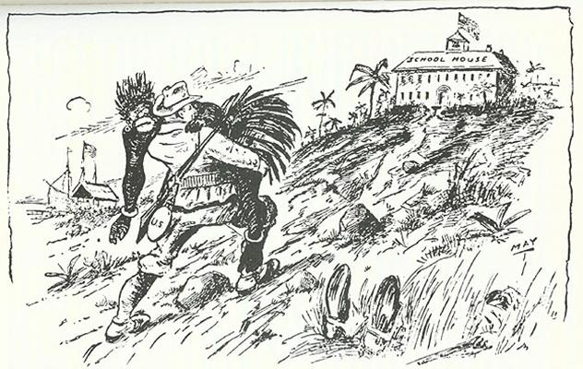
Take up the White Man’s burden–
Send forth the best ye breed–
Go bind your sons to exile
To serve your captives’ need;
To wait in heavy harness,
On fluttered folk and wild–
Your new-caught, sullen peoples,
Half-devil and half-child.
-Rudyard Kipling

Slide 21
THE UNITED STATES,
IMPERIAL POWER HOUSE
The Philippines
Puerto Rico
Organic Act (a.k.a. Philippine Government Act) 1902
President appointed governor; governor appointed upper house of Congress.
Lower house elected by Filipinos.
William Howard Taft served as governor from 1901 to 1904
Improved sanitation, transportation, education, and public health.
Filipino Independence
July 4, 1946
Foraker Act 1900
Granted limited self government and no US citizenship.
President appointed governor and members of upper house.
Lower house elected by the Puerto Ricans.
Insular Cases 1901
Supreme Court ruled NO on US citizenship.
Jones Act 1917
Citizenship extended to Puerto Ricans.

Slide 22
The American Protectorate,
Cuba
Although the U.S. promised to grant Cuba its independence, the U.S. imposed the Platt Amendment to ensure that Cuba would remain tied to the United States.
The Platt Amendment specified the following:
Cuba could not make any treaty with another nation that would weaken its independence or allow another foreign power to gain territory in Cuba.
Cuba had to allow the United States to buy or lease naval stations in Cuba. (Guantanamo Bay)
Cuba’s debts had to be kept low to prevent foreign countries from landing troops to enforce payment.
The U.S. would have the right to intervene to protect Cuban independence and keep order.

Slide 23
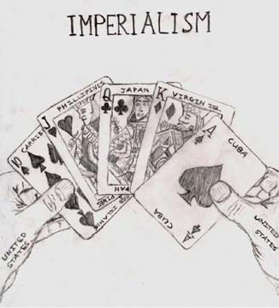

Slide 24
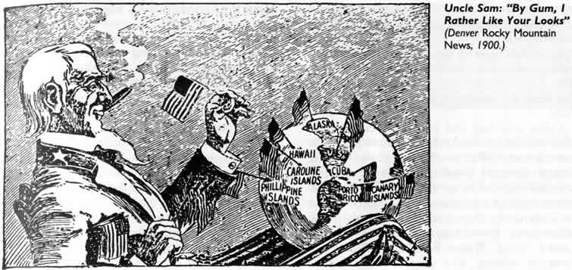

Slide 25
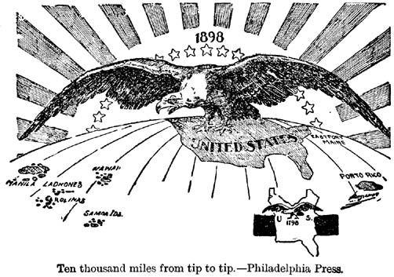

Slide 26
ESSENTIAL CONCLUSIONS
Though the goals of the Spanish-American War were not imperialistic, the United States was clearly a world power as a result of the war.
The Spanish-American War, fought on two fronts, provided the United States with strategic positions in the Pacific and the Caribbean.
The United States acquired the Philippines, Guam, and Puerto Rico as a result of the war, and Cuba became a protectorate of the United States for the next three decades.

Slide 27
HIPPO CLIP
INTERACTIVE MAP: ACQUISITIONS of the SPANISH-AMERICAN WAR

